Slide 1

量子磁性材料中量子相变与临界现象的核磁共振研究
于伟强
中国人民大学物理学系
2023.5.23 @ IOP, CAS

Slide 2
OUTLINE
0. Introduction to quantum critical point (QCP）and NMR
I. KT phase in a 2D TLAFM.
Ref： NC 11, 5631 (2020)
II. Quantum criticality and emergent E₈ state in Quasi-1D Ising magnet under transverse field.
Ref: PRL 123, 067203 (2019); PRL 127, 077210 (2021)
III. Filed induced proximate Kitaev QSL in a honeycomb compound α-RuCl₃.
Ref: PRL 119, 227208 (2017)
IV. NMR evidence of a proximate DQCP in SrCu₂(BO₃)₂ .
Ref: arXiv:2204.08133 (to appear in Science)

Slide 3





Collaborators
Renmin University of China
Yi Cui, Cong Li, Xuefei Liu, Ze Hu
Huihang Lin, Ning Xi, Rong Yu
Boston University
Kai-Hsin Wu, Anders W. Sandvik
Beijing Institute of Technology
Lu Liu
Institute of Physics, CAS
Wenshan Hong, Shiliang Li
…Also thanks to Wenan Guo, Bruce Normand…
Notes:
Who provided extensive numerical simulations to understand our data… Who provide the very high quality single crystals

Slide 4
I. Introduction to Quantum Critical Point
(QCP, 量子临界点)

Slide 5
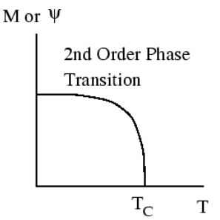
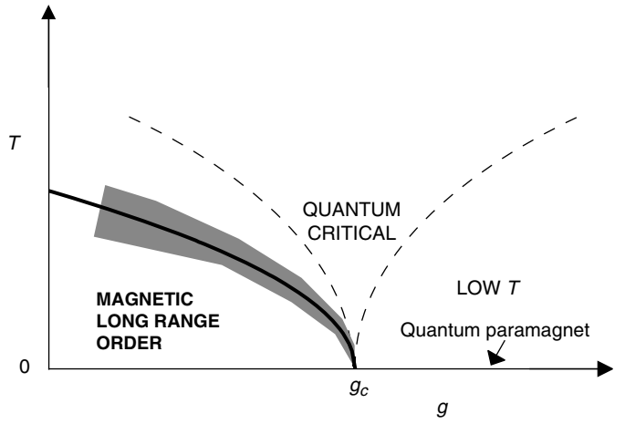
量子临界点：零温的有序-无序二级相变
“经典”相变 (T>0)
g: 压强、磁场、掺杂
铁磁体二级相变
经典朗道相变理论
量子相变 （ T = 0 ）
量子临界区域：非费米液体……
Quantum Phase Transitions, by Sachdev

Slide 6


朗道相变理论：有序-有序（两种不同对称破缺态）之间为一级量子相变

Slide 7



DQCP:违反朗道图像的二级量子相变？
Magnetic driven Deconfined Quantum Critical Point (DQCP)：
产生自旋子解禁闭（分数化元激发）的新途径!

Slide 8
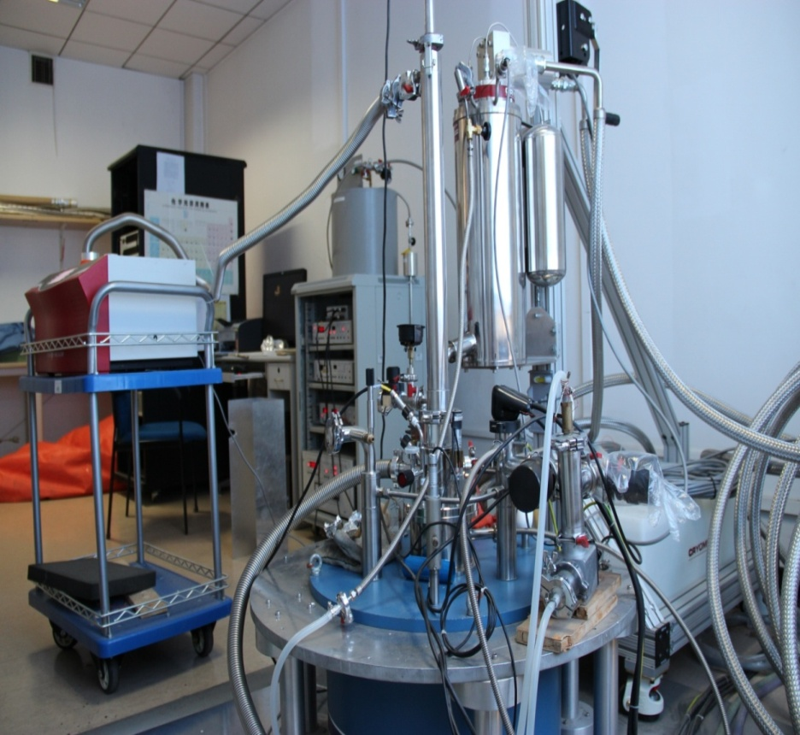
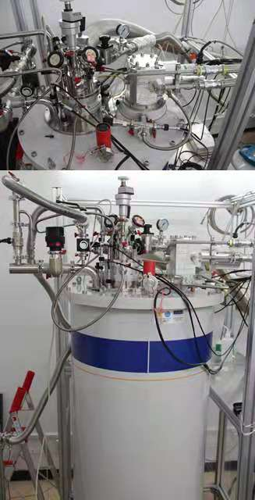
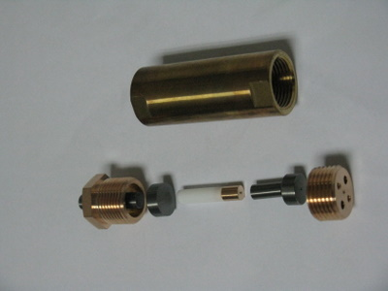
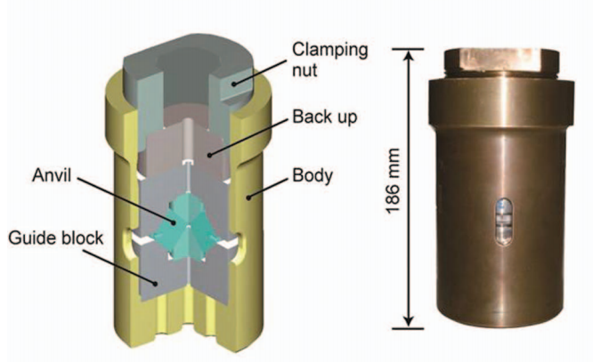
NMR+ 高压、强磁场、极低温 @ 人民大学
16 T
2.4 GPa
25 mK
(bottom loading)
12 T + 1.5 K+ 2.4 GPa
8 GPa (CAC)
10 T
(with IOP, JG Cheng)

Slide 9
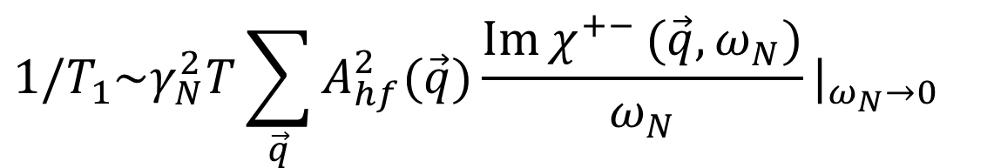
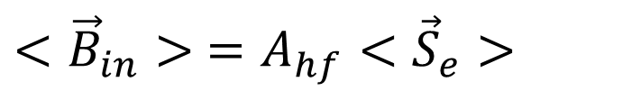
Condensed-matter NMR: A local, low-energy magnetic probe
B
NMR lineshape: static spin/charge distribution
$$<{\vec{B}}_{in}> =A_{hf}<{\vec{S}}_{e}>$$
$$1/T_{1}\sim γ_{N}^{2}T\sum_{\vec{q}}{A_{hf}^{2}(\vec{q})}\frac{\operatorname{Im}{χ^{+−}}(\vec{q},ω_{N})}{ω_{N}}|_{ω_{N}→0}$$
A sensitive probe of electronic charge and magnetism, and their low-energy fluctuations.

Slide 10
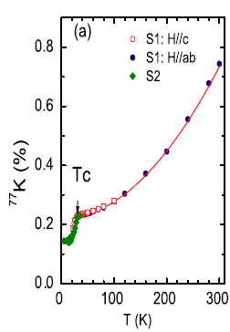
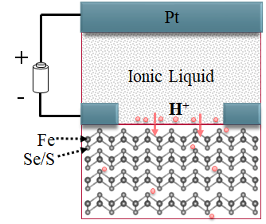
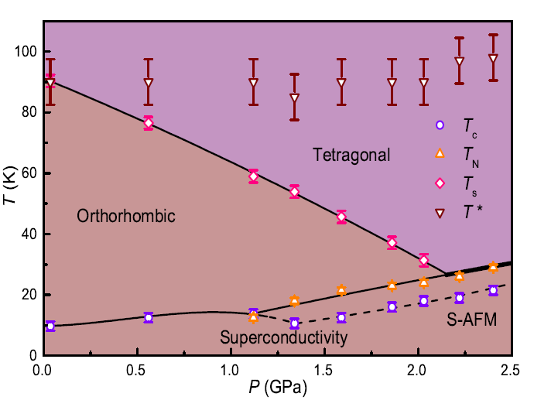
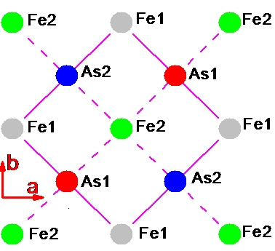
自旋单态配对 PRL2011
超导和反铁磁微观共存 PRL2012
氢化超导和核磁共振
Sci Bull 2018
铁基超导
超导和磁涨落 PRL 2013
FeSe 条纹磁结构 PRL 2016
(π, π) 电荷序 PRB 2016

Slide 11
Emergent U(1) symmetry and BKT phase transition in a triangular-lattice Ising Antiferromagnet

Slide 12
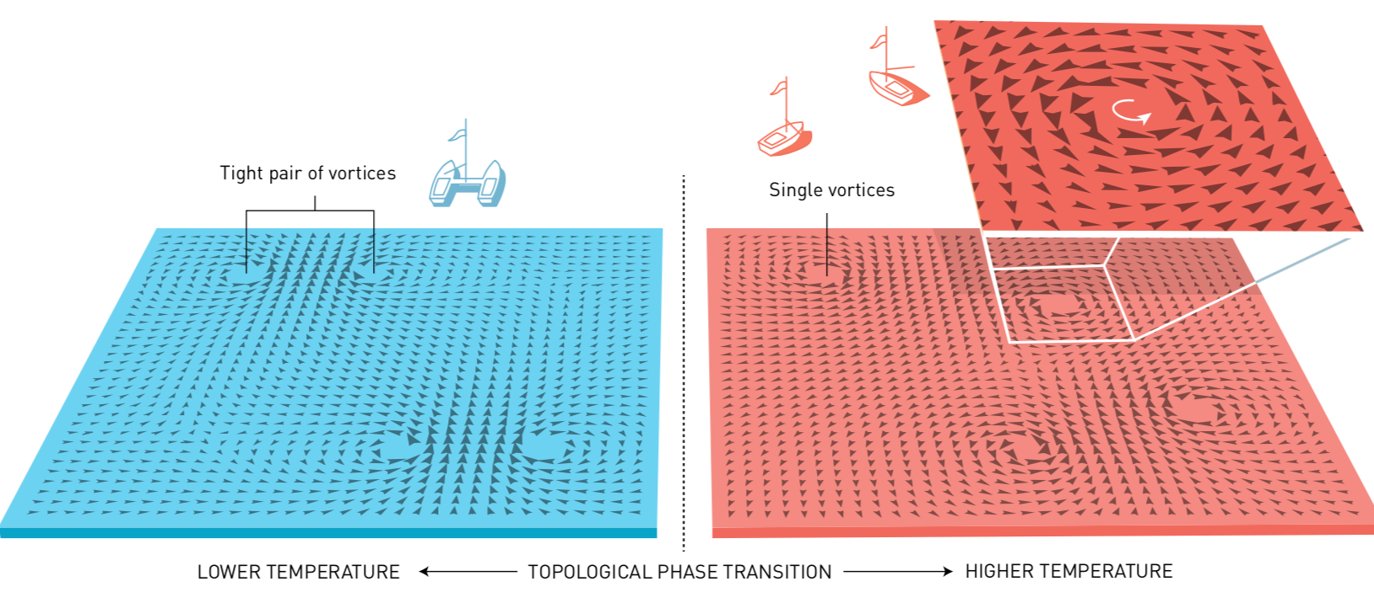

BKT phase transition and vortex excitations
2D XY model with U(1) symmetry:
No long-range order at finite temperature
Direct experimental evidence is lacking for XY magnets !!

Slide 13
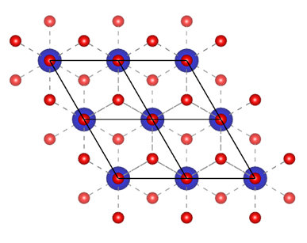
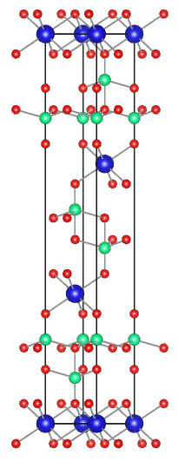
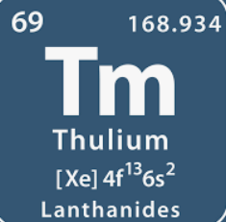
TmMgGaO₄
Tm
Mg, Ga
O
a=3.4195(4) Å
c=25.1231(13) Å
Interlayer = 8.3774Å
Tm³⁺ : 4f¹²
L=5 (l=2,3), S=1 ($↑↑$)
$→$ J=6
YbMgGaO₄, Yuesheng Li et al.,
PRL 117, 097201 (2016)

Slide 14
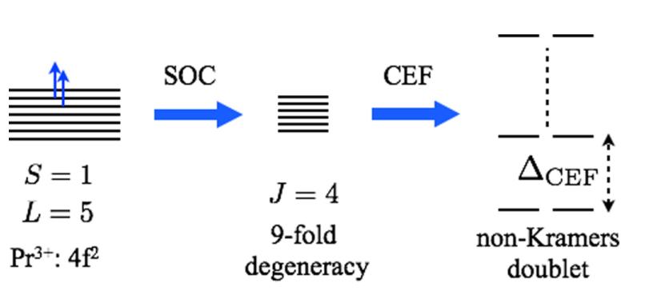
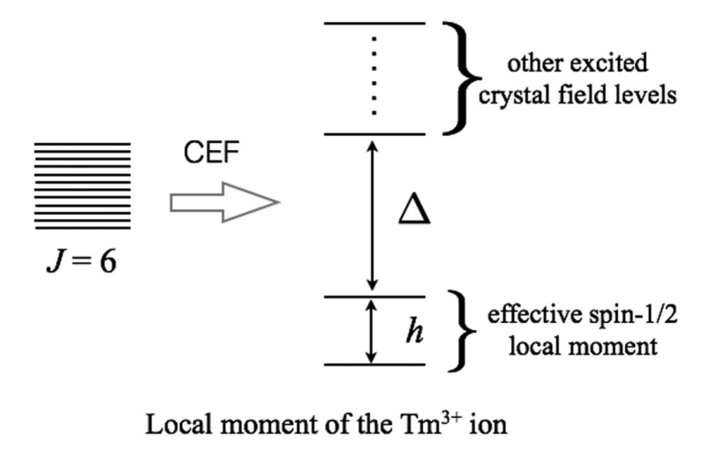
Non-Kramers doublets and intrinsic transverse field
Changle Liu et al., Phys. Rev. B 98, 045119 (2018)
Changle Liu et al., PRR 2,043013(2020)

Slide 15
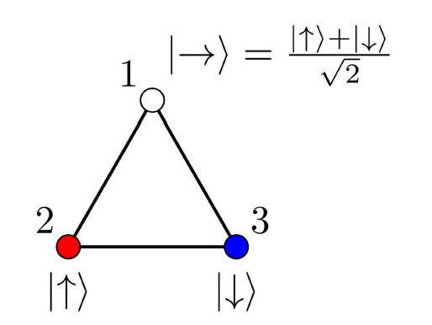
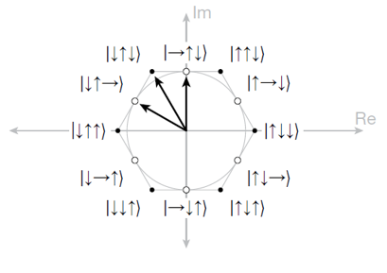
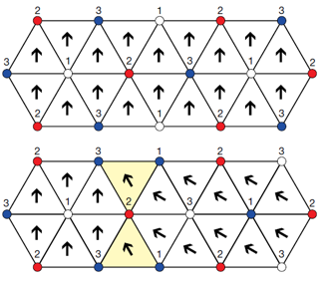
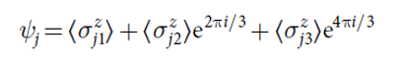
Order by disorder and Emergent Z₆ symmetry in transverse field of triangular lattice AFM
R. Moessner and S. L. Sondhi, PRB 63, 224401 (2001
King, AD et al., Nature 560, 456(2018)

Slide 16
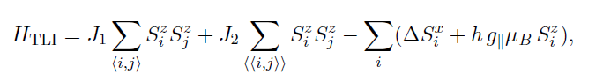
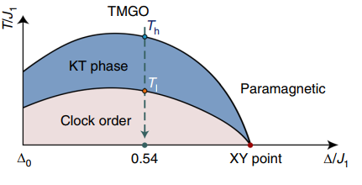
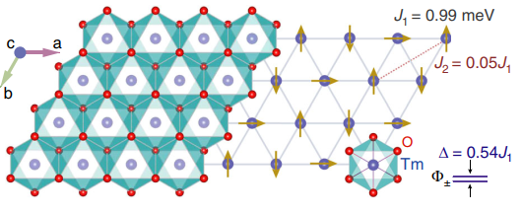
Kosterlitz-Thouless melting of magnetic order
H. Li et al., Nat. Commun. 11, 1111(2020)

Slide 17
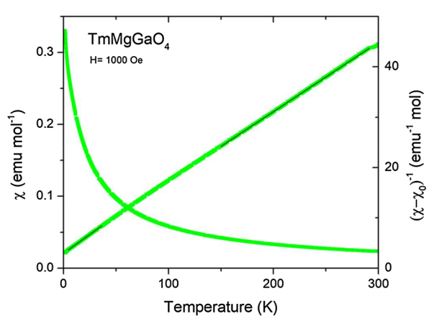
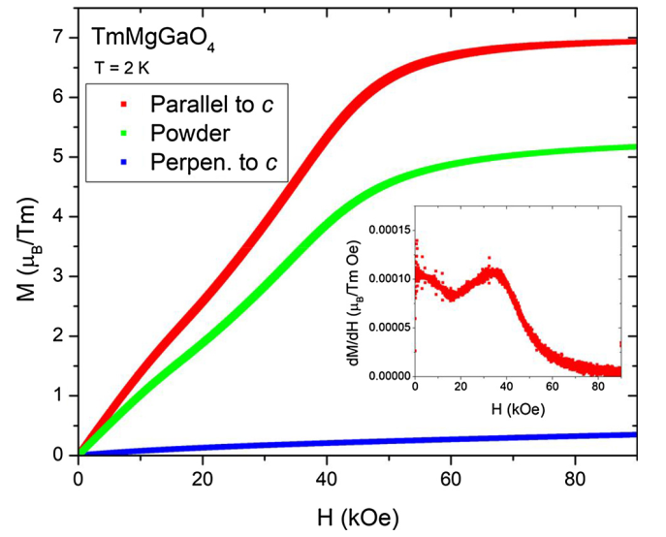
Anisotropic spin model : g_{ab}~0
F. A. Cevallos et al., Mater. Res. Bull. 105, 154–158 (2018).

Slide 18
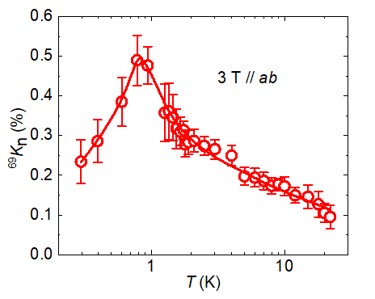
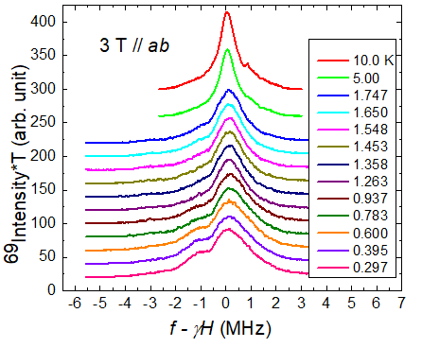
NMR evidence of Magnetic ordering
NMR spectra
Knight shift
ordering temperature
T_{L} ≃ 0.9 K

Slide 19
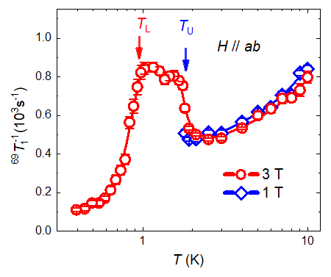
Experimental evidence of BKT phase in TMGO
plateau-like structure between
T_{U} ≃ 1.9 K and T_{L} ≃ 0.9 K
→The hallmark of a BKT phase:
A fluctuating phase with diverging correlation length but no long-range order

Slide 20
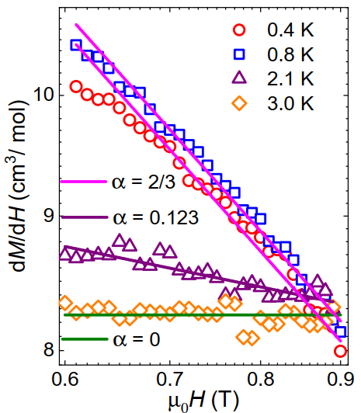
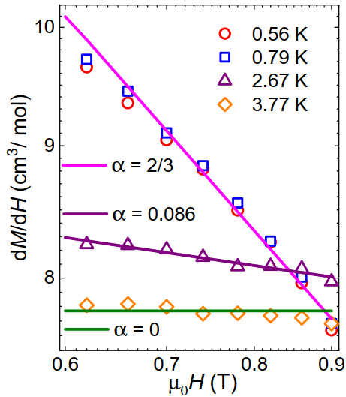
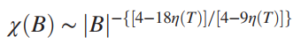
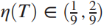
Susceptibility scaling
QMC
Z. Hu et al.,
Nature Commun. 11, 5631 (202RL0)
Kedar Damle,
PRL 115, 127204 (2015)

Slide 21
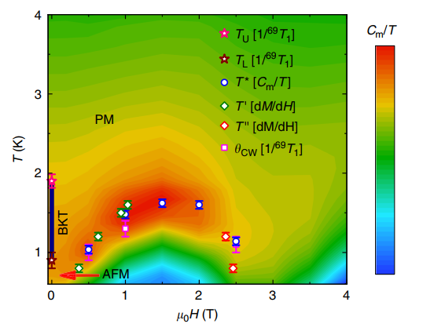
Phase diagram of TMGO under out-of-plane field
A BKT phase between T_{L} and T_{U} under zero out-of-plane field
A field induced quantum phase transition at the high-field side of the dome
Z. Hu et al., Nature Communications 11, 5631 (2020)

Slide 22
ii. Emergent E₈ algebra state in quasi-1D Ising antiferromagnet with transverse field

Slide 23
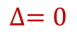



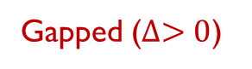
A pedagogical model for Quantum Phase Transitions:
1D Ising-model in a transverse field
Renormalized classical
1D fluctuations
$$∆=0$$
$$∆<0$$
3D quantum criticality
deconfined spinons
$$∆>0$$
3D
1D
Gapped ($∆>0$)
Gapped ($∆>0$)
Quasi-1D Phase Diagram
1D Phase diagram
S. Sachdev, Quantum Phase Transitions (2011）

Slide 24
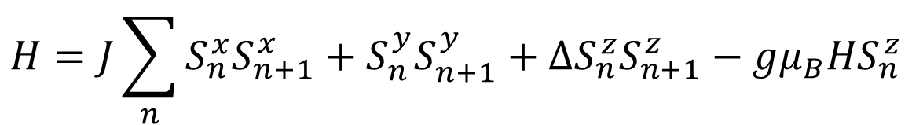
From the Ising chain to the XXZ chain at zero-field
$$H=J\sum_{n}{S_{n}^{x}S_{n+1}^{x}+S_{n}^{y}S_{n+1}^{y}+∆S_{n}^{z}S_{n+1}^{z}−{gμ_{B}HS}_{n}^{z}}$$
two-spinon continuum
Mikeska & Kolezhuk, in Quantum Magnetism (2004）

Slide 25
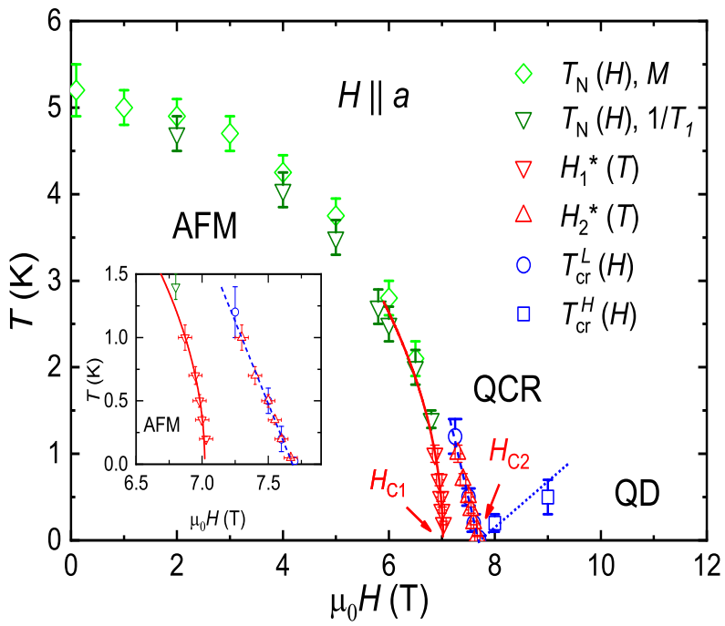
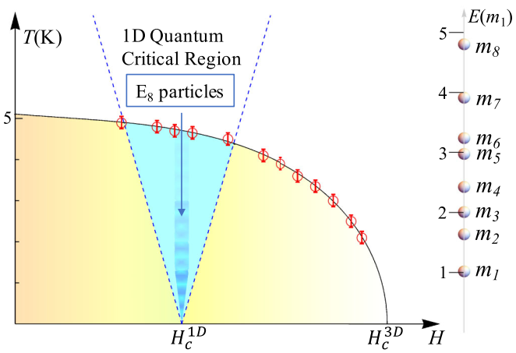
准一维横场依辛模型的自旋子束缚态—E₈态
SrCo₂V₂O₈
T_{cr}^{L} ∼ |H − H_{C2}|
1D critical exponent νz = 1
BaCo₂V₂O₈
E₈ particles at a hidden 1D QCP
Y. Cui et al., PRL 123, 067203 (2019)
H. Zou, Y. Cui et al., PRL 127, 077210 (2021)

Slide 26
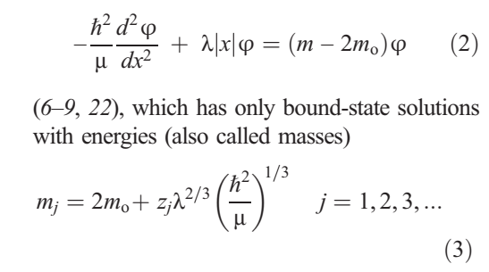
Ising-chain Ferromagnet CoNb₂O₆ in a transverse field
3D Kink confinement at H = 0
W. Kinross et al., PRX 4, 031008 (2004)
E₈ spectrum at H < ~ H_{C}
R. Coldea at al., Science 327, 177 (2010)

Slide 27
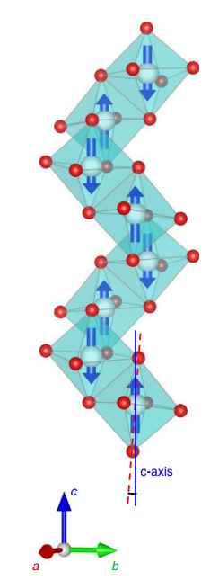
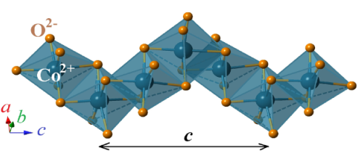
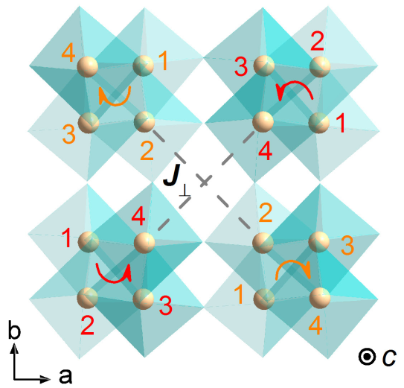
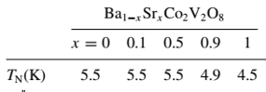
Screw chain antiferromagnet BaCo₂V₂O₈ & SrCo₂V₂O₈
BaCo₂V₂O₈
SrCo₂V₂O₈
space group: I4₁cd a=b=12.267 Å c=8.424 Å
J ≈ 3 mev, Δ ≈ 2 J’ ≈ 0.17 mev
4-site period Opposite screwing direction for n.n chains
4.8º
space group: I4₁/acd
a=b=12.444 Å c=8.4153 Å
Z. He et al. 2005 & 2006;Bera et al. 2017;
Q. Faure et al. 2018.....

Slide 28
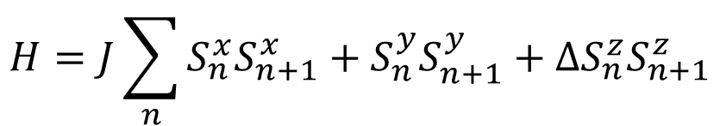
(Ba,Sr)Co₂V₂O₈: Quasi-1D XXZ model with easy-axis anisotropy
$$H=J\sum_{n}{S_{n}^{x}S_{n+1}^{x}+S_{n}^{y}S_{n+1}^{y}+∆S_{n}^{z}S_{n+1}^{z}}$$
S = 1/2
BaCo₂V₂O₈
J ≈ 2.87 mev, Δ ≈ 1.89
J’ ≈ 0.17 mev
H//c
Kimura PRL 99, 087602 (2007)
Q. Faure et al., Nat. Phys. 14, 716 (2018)
….
SrCo₂V₂O₈
J ≈ 3.7 mev, Δ ≈ 2.1
Larger J, but lower T_{N}
Strong suppression of the AFM ordering by a longitudinal field
Kimura 2013; Bera 2014; Wang 2015 …

Slide 29
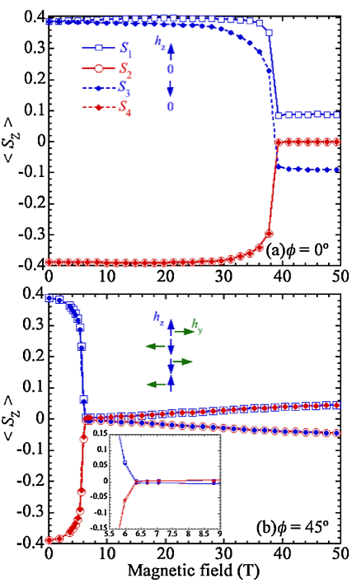
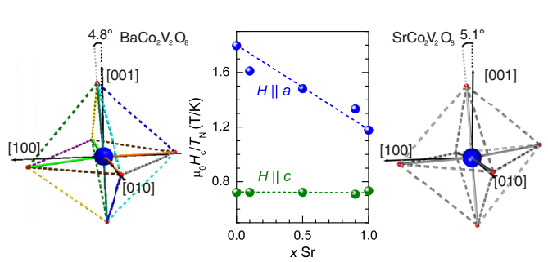
Induced staggered fields in BaCo₂V₂O₈ with H//[0 1 0]
H//[100]:
H//[110]
4-period staggered H_{z}
2-period transverse H_{y} : Strong suppression of AFM
H//[100]
H_{y}/H₀=0.4 ; H_{z}/H₀=0.14
H//[110]:
a 4-period staggered H_{z}
H₀ || a induces a staggered field H₀ along the b-axis
S. Kimura, et al., JPSJ 82, 033706 (2013)

Slide 30
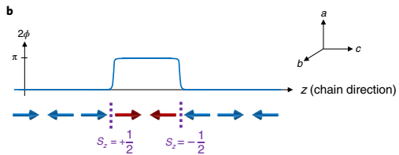
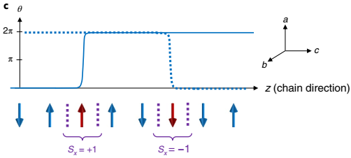
BaCo₂V₂O₈ with H || [010] :
A Topological quantum phase transition?
Low-filed (H<H_{c}),
spinon excitations
High-filed (H_{c}<H<H_{s}),
magnon-like excitations
H || b induces 2-site period Ha
Q. Faure et al., Nat. Phys. 14, 716 (2018)

Slide 31


THz study of SrCo₂V₂O₈ with H || b : spinon confinement
Linear confining potential by the interchain couplings
From confined spinons to fermions
Z. Wang, et al., PRB 94, 125130 (2016)

Slide 32

Effective staggered field induced by periodic O-Co-O tilting in BaCo₂V₂O₈ and SrCo₂V₂O₈
H_{y}/H₀=0.4
H_{z}/H₀=0.14
H_{y}/H₀=0.29
H_{z}/H₀=0.14
Effective staggered field
A. K. Bera et al., RRB 96, 054423 (2017)
Y. Cui et al., PRL123, 067203 (2019)

Slide 33


1D QCP identified by NMR measurements
T_{N}: 3D order
1/T₁ ∼ T ^{−0.75}e^{−Δ/KBT}
Δ(H) ~ H − $H_{C}^{1D}$
→ $H_{C}^{1D}$: 4.7 ±0.3 T
H. Zou et al., PRL 127, 077201 (2021).

Slide 34

E₈ excitation spectrum near the 1D QCP
Red vertical lines:
8 single E₈ particles
T = 0.4 K
Quantum E₈ integrable field theory
INS dynamical spectra agrees with analytical and numerical results
iTEBD
H. Zou et al., PRL 127, 077201 (2021).

Slide 35

INS spectra peaks at different transverse field
H = 4.7 T: the best agreement with the E₈ predictions
H. Zou et al., PRL 127, 077201 (2021).

Slide 36


Phase diagram of BaCo₂V₂O₈ in transverse field
3D QCP at $H_{C}^{3D}$= 10.4±0.1 T
1D QCP at $H_{C}^{1D}$= 4.7±0.3 T
Realized full E₈ spectrum at 1D QCP
Not a E8 symmetry!
Journal Club of CMP 推荐/ 每月1篇
By M. Oshikawa
H. Zou et al., PRL 127, 077201 (2021)

Slide 37
iii. Field-induced a gapless proximate Kitaev spin liquid in α-RuCl₃

Slide 38




2D Spin liquid: Kitaev model in a honeycomb lattice
B phase: Dirac Majorana fermions (Z₂ QSL)
Pauli Matrix
Exactly solvable
under field:
Gapped excitations
Non-Abelian Anyons
A. Kitaev, Ann. Phys. 321, 2 (2006).

Slide 39



Na₂IrO₃ & α-RuCl₃ : 2D honeycomb lattice/edge sharing octahedra
Na₂IrO₃ : Ir⁴⁺, 5d, s=1/2
T_{N}=18.1K, zigzag order
<M>= 0.22 μ_{B}/Ir
α-RuCl₃ : Ru³⁺, 4d, s=1/2
m_{eff}= 1.73μ_{B}; U = 1.5 eV
F. Ye et al.,
PRB 85, 180403 (2012)
K. W. Plumb et al.,
PRB 90, 041112 (2014)

Slide 40

RuCl₃: SOC Mott Physics
Zigzag Magnetic ordering
Jackeli &Khaliullin
PRL 102, 017205 (2009)
H.-S. Kim et l.,
PRB 91, 241110 (2015)

Slide 41

Kitaev spin liquid (KSL) or Proximate KSL behaviors?
Continuum?
Magnon
(gapped)
A. Banerjee et al., Nature Mater.15, 733(2016)
Gapped Spin excitations in Kitaev QSL:
2 Majorana Fermions + 1 Ising flux
G. Baskaran, et al, PRL 98, 247201 (2007).
K. Ran et al., PRL 118, 107203 (2017)

Slide 42
field suppression of the AFM order
ABC
stacking
AB
stacking
H_{c} ~7.5 T;
a very sharp 2nd or a 1st order transition
JZ WQY et al. PRL 119, 227208 (2017)

Slide 43

³⁵Cl NMR: 3 sites * (1 center + 2 satellites)* PM/AFM=9/18 lines
Large Knight shift
Narrow Center spectra ~ 100 KHz
JZ WQY et al. PRL 119, 227208 (2017)

Slide 44

Field-suppressed Magnetic ordering: A 2D QSL?
ABC stacking
JZ WQY et al.
PRL 119, 227208 (2017)
AB stacking
Johnson et al.,
PRB 92, 235119 (2015)
JZ WQY et al. PRL 119, 227208 (2017)

Slide 45
A field-induced Gapless quantum disordered phase
Nodal-like (gapless) excitations below 16 T
Gapped at H > 16 T
JZ WQY et al.
PRL 119, 227208 (2017)
JZ WQY et al. PRL 119, 227208 (2017)

Slide 46

A novel quantum spin liquid?
(Bosonic) Paramagnetic
d-wave superconductor
(Fermionic) Nodal/Dirac-cone like excitations
→ spin liquid?
$$1/T_{1}T\sim 1/(T−Θ)$$
→ Dirac cones at specific angles by K, Γ model?
Z. Liu & Bruce Normand, PRL 120, 187201 (2018)
JZ WQY et al. PRL 119, 227208 (2017)

Slide 47
Candidate mechanisms below 16 T
Spin excitations in ideal Kitaev spin liquid:
two Dirac Majorana Ferminons + a gapped flux →gapped
(G. Baskaran, S. Mandal, and R. Shankar, PRL 98, 247201 (2007).
Spin excitations in Kitaev spin liquids under field
gapped Majorana Fermions +flux →gapped
3. Spin excitations in 2D Heisenberg under field
magnetization plateaus or the fully saturated states → gapped
X
X
X
JZ WQY et al. PRL 119, 227208 (2017)

Slide 48
Summary on α-RuCl₃
1. A field-induced spin liquid is suggested at H>7.5 T//ab.
2. Gapless (partially gapped) excitations are observed above
the critical field.
3. Nodal-like excitations are suggested, which may be an
evidence of Dirac spinons for a spin liquid.
→ Novel physics toward SOC Mott insulator

Slide 49
iv. Proximate deconfined quantum critical point in a Shastry-Sutherland material
Y. Cui et al., arXiv:2204.08133 (to appear in Science)

Slide 50


DQCP: Numerical proposals & properties
CBJQ model
Continuous QPT
(Beyond the G-L paradigm)
Deconfined fractional excitations (Spinons) in the Quantum critical regime
Emergent symmetry: O(2)⊗Z(4)→O(4)?
change of the Berry phase
High-Tc mechanism (SO(5))?
$$H=−J\sum_{<ij>}{\left(\frac{1}{4}−{\vec{S}}_{i}∙{\vec{S}}_{j}\right)}$$
$$−Q\sum_{<ijkl>}{\left(\frac{1}{4}−{\vec{S}}_{i}∙{\vec{S}}_{j}\right)\left(\frac{1}{4}−{\vec{S}}_{k}∙{\vec{S}}_{l}\right)}$$
T. Senthil et al., Science 303, 1490 (2004);
R. R. P. Singh, Physics 3, 35 (2010);
Sandvik, PRL 104, 177201 (2010);
H. Shao et al., Science, 352, 213 (2016).
……

Slide 51




禁闭：磁有序和自旋波理论
S = ½ 三维铁磁体零温时的磁构型
非零温时的自旋波涨落 ：磁振子
单一色散关系
$$∆S=1$$
玻色型元激发

Slide 52

2)解禁闭途径一：反铁磁海森堡自旋链（S = ½）
SrCuTe₂O₆，中子散射连续谱， S. Chillal et al., PRB 104, 144402 (2021)

Slide 53






解禁闭：S = ½ 反铁磁海森堡自旋链中的自旋子
解禁闭的分数化元激发（S= ½，费米型）
$$ε\left(k\right)=\frac{π}{2}J\left|sink\right|$$
一维S=1/2 反铁磁系统
vs
$$ΔS=1 (2个畴壁)$$
$ΔS=1/2$ $(自旋子)$
$$ΔS=1/2$$
$$ε=ε_{1}+ε_{2}$$
$$k=k_{1}+k_{2}$$
$$ε_{1}\left(k_{1}\right)=\frac{π}{2}J\left|sink_{1}\right|$$
$$ε_{2}\left(k_{2}\right)=\frac{π}{2}J\left|sink_{2}\right|$$
连续谱
Quantum Magnetism, by Schollwöck et al.

Slide 54





解禁闭：自旋阻挫体系和量子自旋液体
三
角
晶
格
笼
目
晶
格
烧
绿
石
晶
格
蜂
巢
Kitaev
模
型
量子自旋液体态 (S=0) & 解禁闭自旋子
在α-RuCl₃ 中，通过磁场调控发现具有无能隙自旋子的量子自旋液体态特征。 J. Zheng et al., PRL 119, 227208 (2017)

Slide 55


Artificial model: EPJQ and fractionalization
DQCP in EPJQ model
Excitation continuum
Gapless at (π,0) & (π, π);
Spinon coupled to an emergent gauge field
Regular QCP
No continuum
N. Ma et al.,
PRB 98, 174421 (2018).
Notes:
对比 π0 和ππ位置都无能隙的连续谱；并且整个能谱的下边界，谱权重明暗分布有强烈的变化，这说明spinon不是不理的自由粒子，而是与分数化过程中的演生出来的规范场强烈耦合正。能谱中权重明暗的变化其实是物质场和演生规范场强烈耦合的结果。说明DQCP和高能物理学中夸克禁闭到去禁闭相变的共通性，是在凝聚态物理系统中重现了高能物理学现象。

Slide 56
II. Shastry Sutherland model (SSM) , materials, and quantum phase transitions

Slide 57

A realistic model: Shastry-Sutherland model
Dimer singlet
Plaquette singlet
J/J ' < 0.675, exact dimer singlet
J/J ' >0.765, AFM
Plaquette singlet (VBS):
Mirror symmetry breaking by dimers &double degeneracy
DQCP? (价键晶体态---反铁磁态)
Shastry & Sutherland, Physica 108B, 1069 (1981);
A. Koga et al., PRL 84, 4461 (2000);
P. Corboz et al., PRB 87, 115144 (2013);
J. Guo et al., PRL 124, 206602 (2020);
……

Slide 58


SrCu₂(BO₃)₂ : A Shastry-Sutherland material
J '∼85 K, α = 0.635
SrCu₂(BO₃)₂
J/J ' tuned by pressure
Tetragonal: a = 8.995 Å
c = 6.649 Å
H. Kageyama et al., Physica B 329, 1020 (2003)；
M. E. Zayed et al., Nat. Phys. 13, 962 (2017).

Slide 59


Quantum phase transition in SrCu₂(BO₃)₂
J. Guo et al., PRL 124, 206602 (2020).
Notes:
AFM相互作用，导致基态为二聚体态。

Slide 60


NMR Results Preview: (P, H,T ) Phase diagram
Plaquette liquid phase
full-plaquette VBS phase
AFM ordered phase
A proximate DQCP between VBS-AFM
Y. Cui et al., arXiv:2204.08133
Notes:
Before going to the details , I would like to fist present our experimental results. Under a constant pressure at 2.1 GPa,
We found a plaquette liquid phase at high temperature.
At low temperatures, a full-plaquette ground state is identidfied in contrast to the pure SS model.
We also found the magnetic field suppresses the PS phase and induces a AFM phase with a nearly continuous phase transition which supports
A deconfined quantum criticality with emergent O(3) symmetry. Now let me try to convince you.

Slide 61
III. NMR evidence of a Valence-bond-solid (VBS) state and an AFM state in SrCu₂(BO₃)₂

Slide 62


high-pressure ¹¹B (I = 3/2) NMR on SrCu₂(BO₃)₂
f ~ ¹¹γ|H_{ext}+H_{hf}|+mν_{Q}
Hyperfine field
Quadrupole splitting
m = 0, ±1 for I=3/2
Center peak: uniform χ
H is 8° away from c-axis
→4 inequivalent B sites
Satellites:
local lattice structure
Y. Cui et al., arXiv:2204.08133
Notes:
11B is a nice nuclei, as it has spin- three halfs. As shown by the specretra measured in a paramagnetic phase, the 11B spectra contains both a center line and two groups of satellites. Each satellite group has four lines, because each unit cell contains four inequivalent B sites. Note that the resonance frequency of the center peak detects the uniform susceptibility, and the satellite detects local lattice structure through the coupling between the nuclear quadruple moment and the local electric field gradient. By this, both lattice structure and magnetism can be measured.
With this, we would think NMR is a very good probe to reach a combination of high-pressure, high-field and ultra low temperature spectroscopic study.

Slide 63


1) Pressure-induced full-plaquette (FP) VBS state
Large increase of FWHM below 1.8 K
Local EFG effect
Inequivalent B sites
→Structural twinning of the FP phase
Y. Cui et al., arXiv:2204.08133
Notes:
To probe sensitively the local lattice structure, we measured the NMR satellites at a very low field of 0.2 T, so that the magnetic
Broadening of the spectra can be mostly ignored.
We measured the satellite spectra upon cooling, with the lowest temperature of 0.1 K. By this, we found that the linewidth of
Each satellite first increase upon cooling, which indicates lattice fluctuations. Below about 2 K, the linewidth suddenly increases and reaches a large constant value below 1 K. This clearly indicates a phase transition at about 2 K. The increase of the NMR linewidth should indicated the development of the inequivalent B sites which are affected by local EFG. In particular, we think that this is constant with an FP phase.

Slide 64


Empty plaquette (EP) vs full plaquette (FP) phases
Pure SS model: EP phase + Double degeneracy
Satellite
line narrowing
Modified SS model: FP phase + Double degeneracy
Satellite
line split or broadening
Notes:
Why is this? In fact, for the pure SS model, a pressure induced empty plaquette phase is proposed, where the plaquette singlet does not include the dimer bond.
By this, all the B sites resides outside the local plaquette, so that the line narrowing should be expected, which is in contradiction with our results.
On the other hand, the full plaquette phase, inequivalent B sites would be induced at the same position in different domains. It will give the satellite line split or broadening if the split cannot be resolve, because B can be either insides or outside of the local plaquette, considering double degeneracy of the states.
This is indeed the first spectral evidence for the FP phase.

Slide 65


2) field induced AFM at 2.1 GPa
double-peak spectra at fields above 6.2 T
→AFM order due to dipolar H^{c}_{hf}
Phases coexistence at 6.2-6.3 T
→Weakly first-order quantum phase transition.
Notes:
Now, if a higher magnetic field is applied, we found that the center NMR line splits with temperature, clearly indicates an AFM magnetic ordering
Which induces both a positive and a negative hyperfine field relative to the external field. At fiels above 8T, the transition is pretty much like a second order phase transition as shown by the frequency difference of the peaks as a function of temperature, which observes the change of the order parameter.
The transition field, measured at about 0.07 K, show the line splits at about 6.2 T; However, just at about 6.2 T, three peak feature is observed, which suggests the coexistenc of two phases, and therefore a weakly first-order quantum phase transition. Then the question is, how weak it is?

Slide 66


Field-induced AFM: A weakly first-order QPT
M_{staggered} < 0.05 μ_{B}
M_{total}/M_{s} < 0.025 μ_{B}
double-peak spectra above 6.2 T
→AFM order; (dipolar H^{c}_{hf})
Phases coexistence at 6.2-6.3 T →Weakly first-order phase transition.
Magnetic moments lie in the ab plane, easy-plane order
Proximate DQCP?
Y. Cui et al., arXiv:2204.08133

Slide 67
IV. NMR evidence of a field-induced proximate DQCP in SrCu₂(BO₃)₂
Y. Cui et al., arXiv:2204.08133 (to appear in Science)

Slide 68

1: T_{P} and T_{N} determined by 1/T₁
T_{P}: plaquette phase transition
T_{N}: AFM phase transition
T_{P} & T_{N}: Peak positions in 1/T₁(T)
Y. Cui et al., arXiv:2204.08133
Notes:
In fact, the phase transitions can be precisely determined by the NMR spin-lattice relations rate 1/T1.
At 2.1 Gpa, the 1/T1 data are shown as a function of temperature shown : for the low field, there is a peaked feature in 1/T1 at a specfic temprature , which reveals the onset of the plaquette phase.
At high fields, also a peaked feature is clearly seen in 1/T1 , which reveals the AFM phase transition.
Also for a pressure of 2.4 Gpa. Both the plaqutte transition temperature and the AFM transition temperature can be determined. However, the plaquette in the this one is determined by a deviations of the power-scaling which I am not going to the details.

Slide 69
(H,T) Phase diagram at P = 2.1 GPa
J. Guo et al., PRL 124, 206602 (2020)
J. L. Jimenez et al., Nature 592, 370 (2021)
A weakly first-order quantum phase transition
Y. Cui et al., arXiv:2204.08133
Notes:
All the transition temperature can be plotted as a function of field, such as at 2.1 Gpa. This is exactly the phase diagram that I show before.
Interestingly, the transition temperature drops sharply from both sides and meets at about zero temperature.

Slide 70

2: A Proximate DQCP
Scaling behaviors → duality
T_{P,N} = T_{b} + a_{P,N} |H − H_{b}|^{ϕ}
2.1 GPa:
H_{b} = 6.184±0.05 T
T_{b}= 0.066±0.010 K
ϕ = 0.569±0.025
2.4 GPa:
H_{b} = 5.719±0.006 T
T_{b}= 0.062±0.012 K
ϕ = 0.498±0.031
Small T_{b} → a proximate DQCP;
Duality → an emergent symmetry to support the DQCP
Y. Cui et al., arXiv:2204.08133
Notes:
In fact, our careful measurents show that for bout 2.1 Gpa and 2.4 Gpa. The PS and the AFM are connected by a bicritical point with a temperature about 0.06 K. This suggests that the transition is nearly continuously, which supports a proximate DQCP.
Furthermore, the transition lines are found to follow a power-law field dependence when away from the critical field; In fact the power-law exponent is identical for both the PS and the AFM phase, which suggests a duality of two phases. Therefore, an emergent symmetry is suggested to support the DQCP.

Slide 71

Fits of the T_{P} and T_{N}: scaling and duality
T_{P,N} = T_{c} + a_{P,N}|H₀ − H_{c}|^{φ}
T_{P,N} = A_{P,N} ln⁻¹ |C_{P,N}(H − H_{c})|
Y. Cui et al., arXiv:2204.08133

Slide 72


3: Level crossing of the plaquette gap
1/T₁T∼ e^{−∆/KBT} in the PS state;
Δ decreases linearly with fields and vanishes at the QPT.
CBJQ model, SSE+QMC
Gapless at the QPT
Close to a continuous transition
→Emergent continuous symmetry?
Y. Cui et al., arXiv:2204.08133

Slide 73


4: Quantum criticality
1/T₁= b(H) + aT^{η}
b_{H} ∞ (H_{c} − H₀)^{d}
2.4 GPa vs 2.1 GPa data
Lower staggered m at Hc;
2.4 GPa is closer to the DQCP
Proximate DQCP
η = 0.20±0.02;
d = 0.77±0.04
Y. Cui et al., arXiv:2204.08133

Slide 74


5: Emergent Symmetries
m_{p}: the order parameter of the PL phase
At the transition
Uniform distribution
In the AFM phase
Single-peak
In the PL phase
Double-peak
SSE+QMC on CBJQ Model
Z₂ symmetry breaking
Emergent O(3) symmetry from U(1)*Z2
U(1) symmetry breaking
Y. Cui et al., arXiv:2204.08133
Notes:
This is indeed supported by the numerical simulations based on CBJQ model.
The histogram of the plaqute order mp has a double peak at low field, but a rectangular type at the critical field, which suggest that there is an emergent O(3) symmetry, which recovers from the U(1) symmetry breaking in the AFM phase and the Z2 symmetry breaking in the plaquette phase.

Slide 75

Future studies 1: (P, H, T) phase diagram
The first experimental realization of a proximate DQCP, which offers a platform for studies of novel properties.
O(4) DQCP at higher pressures?
Fractional excitations?
Multiple critical point?
QSL?
Notes:
We further compare the data between 2.1 Gpa and 2.4 Gpa. It found that at the critical field, the staggered m is lower at higher pressures, which indicate the transition is more continuous; The smaller power-law exponent fai at 2.4 Gpa also suggests a more continuous transition at 2.4 GPa. Therefore, 2.4 Gpa is closer to the DQCP. This is illusteated by a 3D cartoon phase diagram with (P, H, T). With increase of pressure, the system going towards a real DQCP which connect to a possible QSL.

Slide 76

2: Plaquette Liquid phase
A_{hf} <0
Decrease of uniform χ
f₁ → DS phase
f₂ → PS phase
Phase coexistence at 1.85 GPa
Y. Cui et al., arXiv:2204.08133

Slide 77

Plaquette Liquid phase
A_{hf} <0
P < 1.85 GPa, a crossover to the DS;
P ≥ 1.85 GPa, a sharp crossover at T* with no evidence of symmetry breaking→ plaquette liquid phase→ A QSL?
Y. Cui et al., arXiv:2204.08133

Slide 78

3: homogeneous vs inhomogeneous P
first-order
J. Guo et al., PRL 124, 206602 (2020)
J. L. Jimenez et al., Nature 592, 370 (2021)
Pressure homogeneity is very important!
Notes:
SBCO is a SS materials which is tunable by pressure, and offers very interesting phases as illustrated by the phase diagram which were constructed by the previous speaker and also Jimenez at al. It contains dimerized singlet phases, Plauette singlet phase and antiferromagnetic phase with increasing pressures.
However, there are still outstanding questions. Because these phase diagram are constructerd by the specific heat,
Spectrascopic studies are needed to confirmed these phase, and also the structure of the phases. For example. Is the plaqutte phase of an empty plquett or a full plaqutte phase? Second, is there a continuous phase transition between the plaquette singlet and the AFMphase to support a dQCP? But this is a hard question, because 2.5 Gpa and avove is very hard to obtain. In this work, we would focus on the NMR study on two pressures slightly below 2.5 Gpa, that is, 2.1 and 2.4 GPa

Slide 79
Summary
Symmetry breaking evidence for a pressure-induced full-plaquette VBS phase are established in SrCu₂(BO₃)₂.
A pressure-induced plaquette liquid phase is observed.
Symmetry breaking evidence for a field-induced AFM phase are resolved in SrCu₂(BO₃)₂.
A proximate DQCP is firmly established for the first time.
Low transition temperature at the QPT
Duality of T_{P} and T_{N} with field
Quantum Critical scaling
An emergent O(3) symmetry
Y. Cui et al., arXiv:2204.08133 (to appear in Science)
Notes:
Finally, I would like to summarize our resluts. We resolved a full plaquette phase and the for the first time.
We also found a field-induced weakly first-order QPT between PS and the AFM phase.
A duality of TP and TN is also suggested by a power-law scaling behavior.
From this, we conclude that a primicate DQCP with emergent symmetry is established.
With this initiative work, studies are proposed. The first is to look for direct evidence of fractional excitations at the proximated DCP; the second is to study the phase as even higher pressures? Would there be a DQCP and QSL? Thank you for your attention.

